Slide 1

N-Queens Problem
A classic Puzzle in Computer Science

Slide 2

Team Members
Sr No | Name | Roll Number | Email
1. | Nishchay Bhardwaj | 381009 | nishchay.22211583@viit.ac.in
2. | Vaibhav Golhar | 381023 | vaibhav.22210180@viit.ac.in
Department of Computer Science & Engineering (Artificial Intelligence), BRACT's VIIT Pune - 48

Slide 3
Agenda
Introduction to N-Queens Problem
Constraint in the N-Queens Problem
Key Concepts and Algorithms
N-Queens as a Constraint Satisfaction Problem (CSP)
Real-World Applications of N-Queens Problem
Examples Similar to N-Queens That Use Backtracking
Conclusion
Department of Computer Science & Engineering (Artificial Intelligence), BRACT's VIIT Pune - 48

Slide 4
Introduction to N-Queens Problem
The N-Queens problem is a famous challenge in computer science and mathematics. It involves placing N chess queens on an N x N chessboard in such a way that no two queens threaten each other. In other words, no two queens can share the same row, column, or diagonal.
This seemingly simple puzzle presents a complex problem with many potential solutions, making it an excellent example of constraint satisfaction and combinatorial optimization.
Department of Computer Science & Engineering (Artificial Intelligence), BRACT's VIIT Pune - 48

Slide 5
Constraints in the N-Queens Problem
Row Constraint
Column Constraint
Diagonal Constraint
Only one queen can occupy each row of the chessboard. This constraint ensures that no two queens can threaten each other along the same horizontal line. It is a fundamental rule of the N-Queens problem, forming the basis for finding valid solutions.
Similar to the row constraint, only one queen can occupy each column of the chessboard. This constraint prevents queens from attacking each other along the same vertical line. It is crucial for maintaining the non-threatening placement of queens on the board.
This is the most challenging constraint to visualize and implement. No two queens can be placed on the same diagonal line. This constraint applies both to the main diagonals (top-left to bottom-right) and the anti-diagonals (top-right to bottom-left) of the board.
Department of Computer Science & Engineering (Artificial Intelligence), BRACT's VIIT Pune - 48

Slide 6
Key Concepts and Algorithms
Backtracking Algorithm: Backtracking is the primary approach used to solve the N-Queens problem. The idea is to incrementally build solutions, and if placing a queen leads to a conflict, we "backtrack" by removing the last placed queen and try placing it elsewhere.
Algorithm Steps:
Start placing queens column by column, beginning from the first column.
For each column, check every row to see if placing a queen is safe.
Use helper functions like Is_Safe() to check if placing a queen in a particular row and column violates any of the constraints.
If placing a queen in a column doesn't lead to a solution, backtrack by removing the last placed queen.
If all queens are placed correctly, print the solution or return it.
Time Complexity: The time complexity of solving the N-Queens problem using backtracking is 𝑂(𝑁!), as there are 𝑁 possibilities for each queen in each column.
Space Complexity: The space complexity is 𝑂(𝑁2), which is required to store the board configuration.
Department of Computer Science & Engineering (Artificial Intelligence), BRACT's VIIT Pune - 48

Slide 7
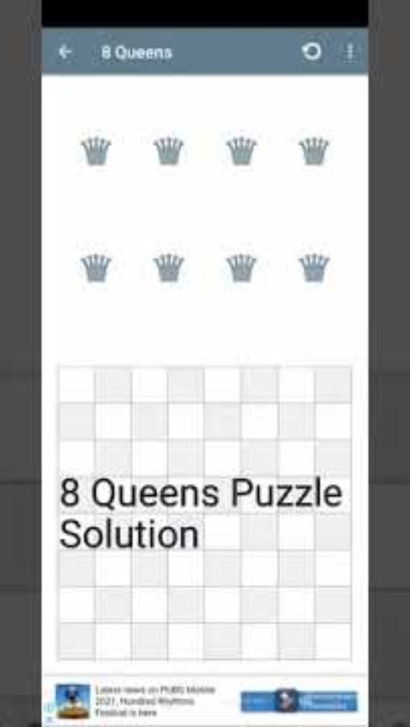
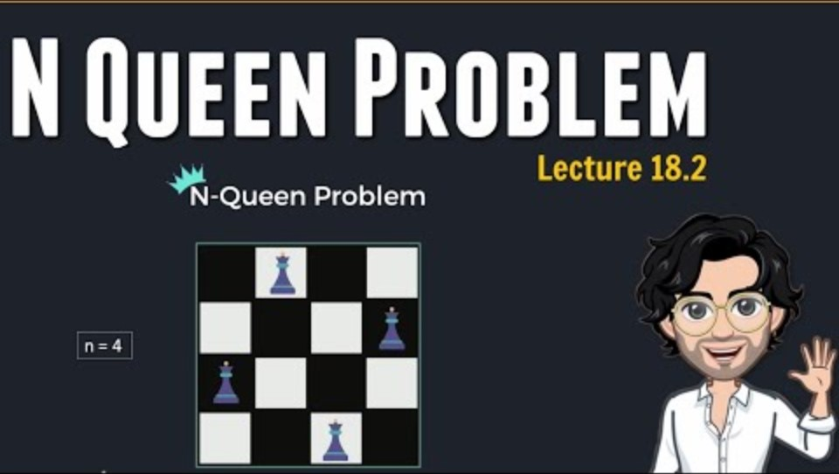
Key Concepts and Algorithms
Department of Computer Science & Engineering (Artificial Intelligence), BRACT's VIIT Pune - 48

Slide 8
N-Queens as a Constraint Satisfaction Problem (CSP)
The N-Queens problem can be modeled as a Constraint Satisfaction Problem (CSP):
Variables: Each queen represents a variable, corresponding to a position on the chessboard.
Domain: The domain for each variable is the set of rows in which a queen can be placed.
Constraints: Queens cannot share the same row, column, or diagonal.
Advantages of CSP:
Efficient search: CSP allows for constraint propagation, reducing the search space by eliminating invalid assignments early.
Modular: CSPs can be easily extended to larger boards or modified for different constraints.
Optimization: CSP frameworks can be used to find optimal solutions in some versions of the N-Queens problem (e.g., with additional constraints).
Department of Computer Science & Engineering (Artificial Intelligence), BRACT's VIIT Pune - 48

Slide 9
Real-World Applications of the N-Queens Problem
Network Routing
Resource Allocation
Finding optimal paths for data transmission in communication networks. The N-Queens problem's constraint satisfaction principles can be applied to minimize interference between communication channels.
Optimizing the placement of resources, such as satellites in space or servers in a data center, to ensure minimal interference and efficient utilization. The N-Queens problem's constraints can be applied to ensure proper spacing and avoid conflicts.
Job Scheduling
Robotics and Automation
Scheduling tasks or jobs in a system to avoid conflicts and maximize efficiency. The N-Queens problem's constraints can be applied to ensure that tasks are assigned to different resources without overlapping.
Planning robot movement and pathfinding in environments with obstacles. The N-Queens problem's CSP can be used to find optimal routes for robots to navigate while avoiding collisions.

Slide 10
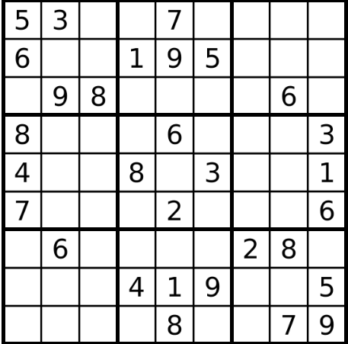
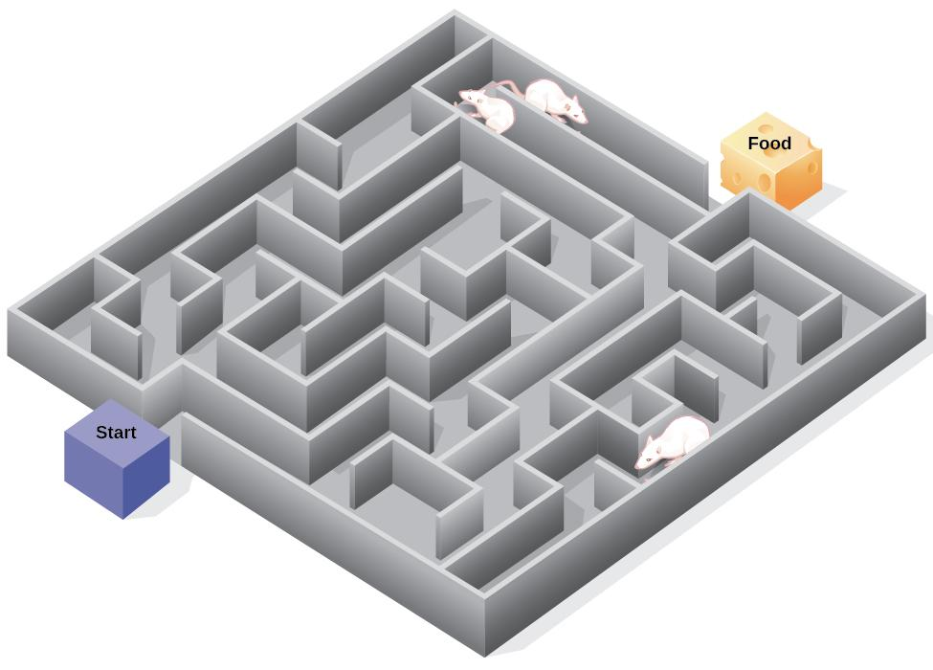
Examples Similar to N-Queens That Use Backtracking:
Sudoku Solver
Problem: Fill a 9x9 grid such that each row, column, and 3x3 subgrid contains the numbers 1 to 9 without repeating.
Backtracking Approach:
Start placing numbers from 1 to 9 in empty cells.
Check if the placement violates any row, column, or subgrid constraints.
If conflicts occur, backtrack by trying another number until the grid is completely filled.
Complexity: Backtracking ensures the exploration of all possible combinations but stops early when conflicts are detected.
Rat in a Maze
Problem: Fill a 9x9 grid such that each row, column, and 3x3 subgrid contains the numbers 1 to 9 without repeating.
Backtracking Approach:
Start placing numbers from 1 to 9 in empty cells.
Check if the placement violates any row, column, or subgrid constraints.
If conflicts occur, backtrack by trying another number until the grid is completely filled.
Complexity: Backtracking ensures the exploration of all possible combinations but stops early when conflicts are detected.
Department of Computer Science & Engineering (Artificial Intelligence), BRACT's VIIT Pune - 48

Slide 11

Conclusion
The N-Queens problem is not just an abstract puzzle; it illustrates core principles of constraint satisfaction and algorithmic problem-solving.
Key Takeaways:
Understanding the importance of constraints in complex problems.
Learning how backtracking is an efficient algorithm for exploring all potential solutions.
Using heuristics and optimization techniques to speed up the search for solutions.
This problem has practical significance across various domains, from network optimization to resource allocation and AI pathfinding.

